Slide 1

Designed to fulfill all personal financial needs.
All Star Code
Yahoo Cohort

Slide 2



Meet the Team
Faisal Hossain
Bao Huynh
Joseph Rodriguez

Slide 3
Money
“Humans are naturally bad with money” - Business Insider’s

Slide 4



Students
Money Problems
Financial
Worries
Expenses
Daily Train Fare
Lunch
Books
Tutoring
Spending
Boba Tea
Clothes
Time with Friends
Video Games
Bao Huynh

Slide 5

Phantom

Slide 6

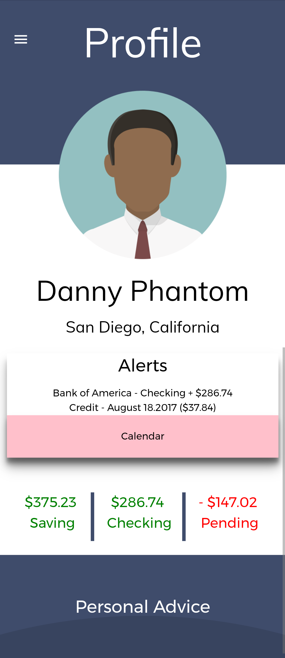
About the App
Track & manage your money
Connect multiple bank accounts
Virtually send money
Pay bills & make payments.
Calculate expenses
Visualize spendings

Slide 7

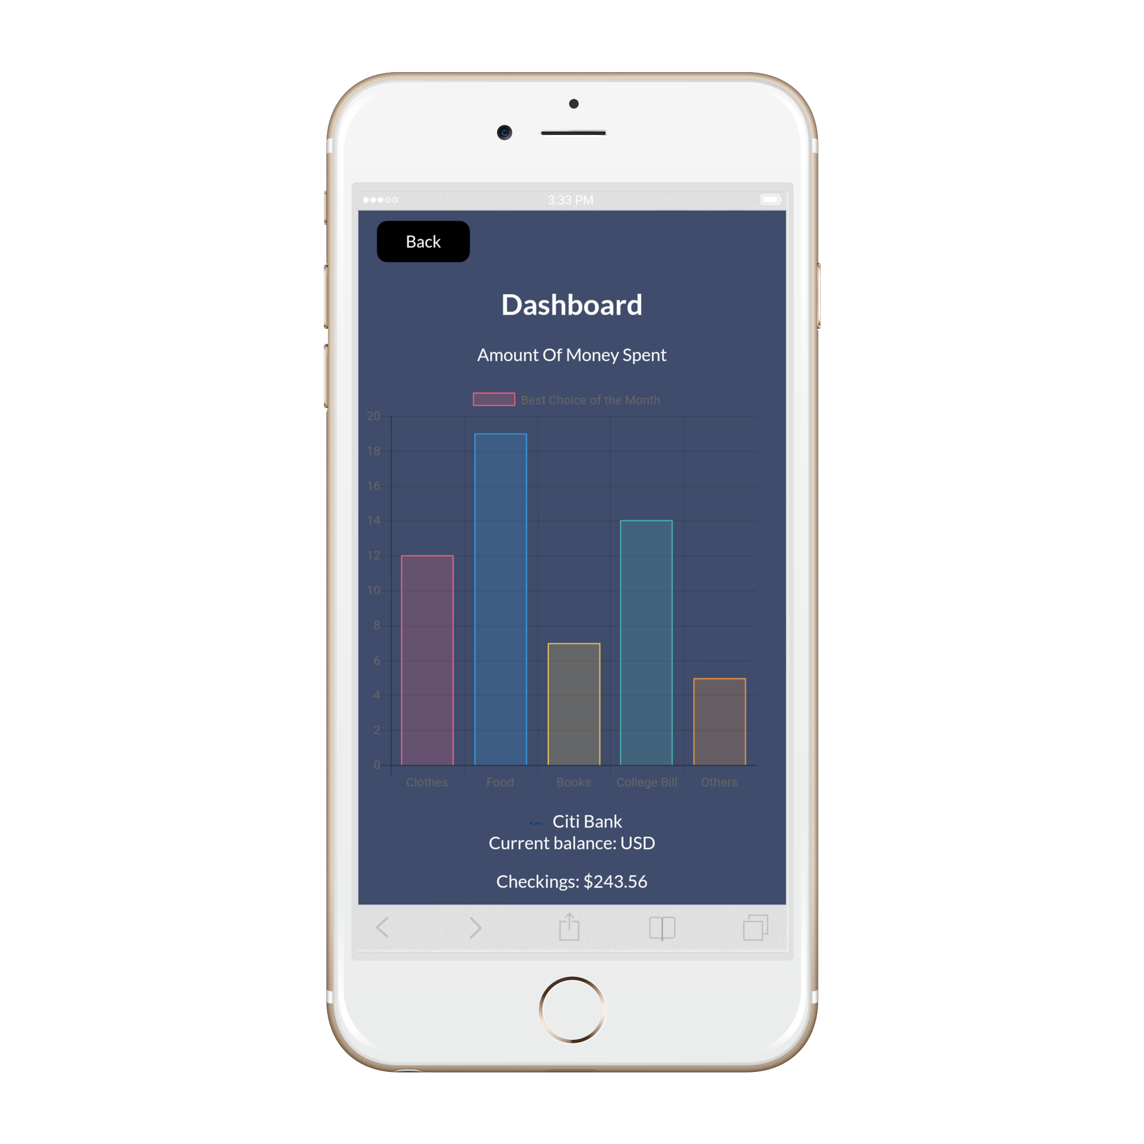
Financial Tools
Event Planner
Pay bills
Make payments
Money Transfer
Visual Charts

Slide 8

Personal Advice
Set financial budget
Receive constructive feedback on how to save
Become notified of surpassing budget
Receive suggestions

Slide 9
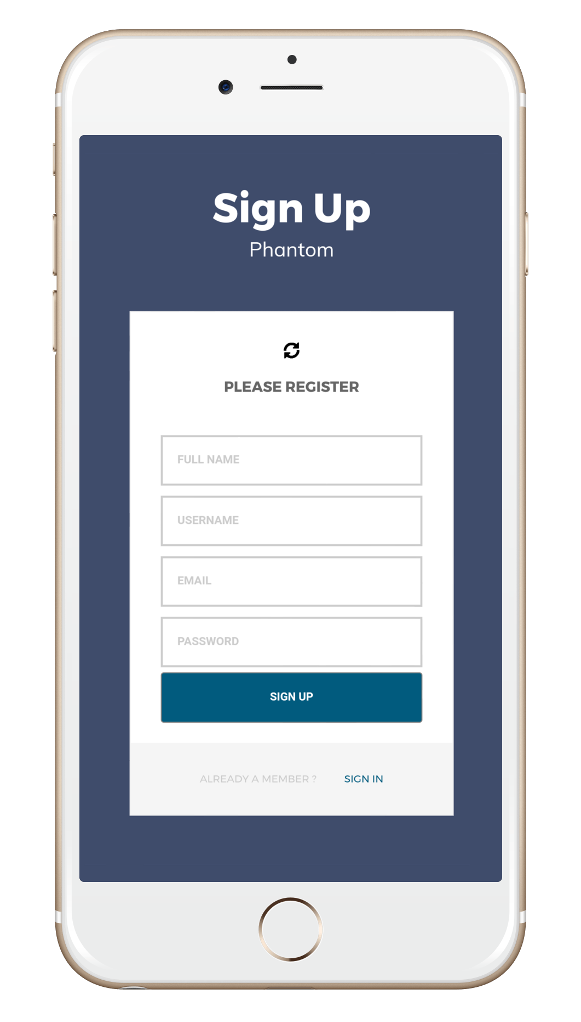
3 Simple Steps
Registering
Connecting
Securing

Slide 10

Fully Responsive

Slide 11
Thank you
For your time
Phantom
We will be taking any questions regarding Phantom at our booth

